Slide 1
Mastering Blockchain
Blockchain 101

Slide 2
Overview
Blockchain 101
Decentralization
Cryptography and Technical Foundations
Bitcoin
Alternative Coins
Smart Contracts
Ethereum 101
Hyperledger
Alternative Blockchains
Blockchain-Outside of Currencies
Scalability and Other challenges

Slide 3
Agenda
Distributed systems
Introduction to blockchain
Types of blockchain
CAP theorem and blockchain
Benefits and limitations of blockchain
Summary

Slide 4
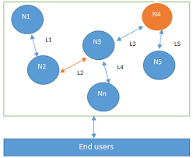
Distributed Systems
CAP theorem
Byzantine Generals problem
Consensus
Consensus mechanisms
Types of consensus mechanism
Notes:
“basically blockchain at its core is a distributed system”
“a computing paradigm whereby two or more nodes work with each other in a coordinated fashion in order to achieve a common outcome and it's modeled in such a way that end users see it as a single logical platform”
Node:
Send and receive message
Can be honest, faulty or malicious
Byzantine node: Unexpected behavior of a node
Main challenge:
Coordination between nodes
Fault tolerance
CAP theorem: proved and states that a distributed system cannot have all much desired properties simultaneously

Slide 5
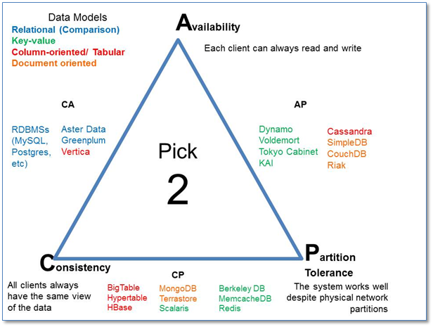
CAP theorem
Notes:
Consistency is a property that ensures that all nodes in a distributed system have a single latest copy of data
Availability means that the system is up, accessible for use, and is accepting incoming requests and responding with data without any failures as and when require
Partition tolerance ensures that if a group of nodes fails the distributed system still continues to operate correctly

Slide 6
Byzantine Generals problem
A group of army generals who are leading different parts of the Byzantine army are planning to attack or retreat from a city
The only way of communication between them is a messenger and they need to agree to attack at the same time in order to win
need to find a viable mechanism that allows agreement between generals even in the presence of treacherous generals so that the attack can still take place at the same time
Practical Byzantine Fault Tolerance (PBFT): Proof of Work (PoW) algorithm
Excerpt From: Imran Bashir. “Mastering Blockchain.” Apple Books.
Excerpt From: Imran Bashir. “Mastering Blockchain.” Apple Books.
Notes:
“1962, Paul Baran introduced the idea of cryptographic signatures with his paper On distributed communications networks”
“Byzantine army are planning to attack or retreat from a city. The only way of communication between them is a messenger and they need to agree to attack at the same time in order to win”
This problem was solved in 1999 by Castro and Liskov who presented the Practical Byzantine Fault Tolerance (PBFT)
Later on in 2009, the first practical implementation was made with the invention of bitcoin where the Proof of Work (PoW) algorithm was developed as a mechanism to achieve consensus

Slide 7
Consensus
Consensus is a process of agreement between distrusting nodes on a final state of data
A consensus mechanism is a set of steps that are taken by all, or most, nodes in order to agree on a proposed state or value:
Agreement
Termination
Validity
Fault tolerant
Integrity
Types of consensus machanism:
Byzantine fault tolerance-based: no intensive operation
Leader-based consensus mechanism
Notes:
Consensus is a process of agreement between distrusting nodes on a final state of data
achieving consensus between multiple nodes is known as distributed consensus:
Agreement: All honest nodes decide on the same value.
Termination: All honest nodes terminate execution of the consensus process and eventually reach a decision.
Validity: The value agreed upon by all honest nodes must be the same as the initial value proposed by at least one honest node.
Fault tolerant: The consensus algorithm should be able to run in the presence of faulty or malicious nodes (Byzantine nodes).
Integrity: This is a requirement where by no node makes the decision more than once. The nodes make decisions only once in a single consensus cycle.
Type:
Byzantine fault tolerance-based: With no compute intensive operations such as partial hash inversion, this method relies on a simple scheme of nodes that are publishing signed messages. Eventually, when a certain number of messages are received, then an agreement is reached.
Leader-based consensus mechanisms: This type of mechanism requires nodes to compete for the leader-election lottery and the node that wins it proposes a final ”

Slide 8
Introduction to blockchain
Various technical definitions of blockchains
Generic elements of a blockchain
Features of a blockchain
Applications of blockchain technology
Tiers of blockchain technology

Slide 9
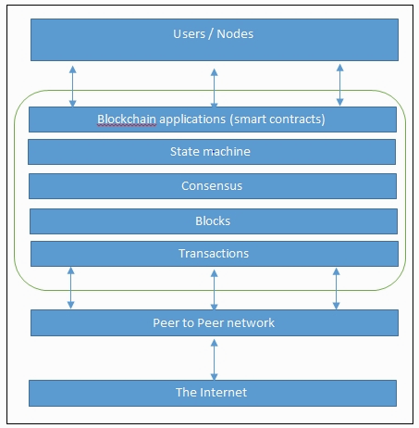
Various technical definitions of blockchains
Blockchain at its core is a peer-to-peer distributed ledger that is cryptographically secure, append-only, immutable (extremely hard to change), and updateable only via consensus or agreement among peers.
Notes:
There are various definitions of blockchain; it depends on how you look at it.

Slide 10
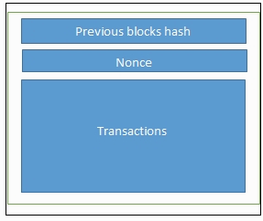
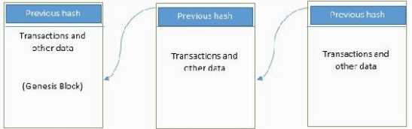
Various technical definitions of blockchains

Slide 11
Generic elements of a blockchain
Addresses
Transaction
Block
Peer-to-peer network
Scripting or programming language
Virtual machine
State machine
Nodes
Smart contracts
Notes:
Addresses are unique identifiers that are used in a transaction on the blockchain to denote senders and recipients”
A transaction is the fundamental unit of a blockchain
A block is composed of multiple transactions and some other elements such as the previous block hash (hash pointer), timestamp, and nonce
P2p: a network topology whereby all peers can communicate with each other and send and receive messages
State machine: A blockchain can be viewed as a state transition mechanism whereby a state is modified from its initial form to the next and eventually to a final form as a result of a transaction execution and validation process by nodes
Smart contract: These programs run on top of the blockchain and encapsulate the business logic to be executed when certain conditions are met

Slide 12
Features of a blockchain
Distributed consensus
Transaction verification
Platforms for smart contracts
Transferring value between peers
Generating cryptocurrency
Smart property
Provider of security
Immutability
Uniqueness
Smart contracts
Notes:
Distributed consensus is the major underpinning of a blockchain. This enables a blockchain to present a single version of truth that is agreed upon by all parties without the requirement of a central authority
Any transactions posted from nodes on the blockchain are verified based on a predetermined set of rules and only valid transactions are selected for inclusion in a block
A blockchain is a platform where programs can run that execute business logic on behalf of the users
This is an optional feature depending on the type of blockchain used
cannot be double spent or double owned
Blockchain is based on proven cryptographic technology that ensures the integrity and availability of data
records once added onto the blockchain are immutable
blockchain ensures that every transaction is unique and has not been spent already
Blockchain provides a platform to run smart contracts

Slide 13
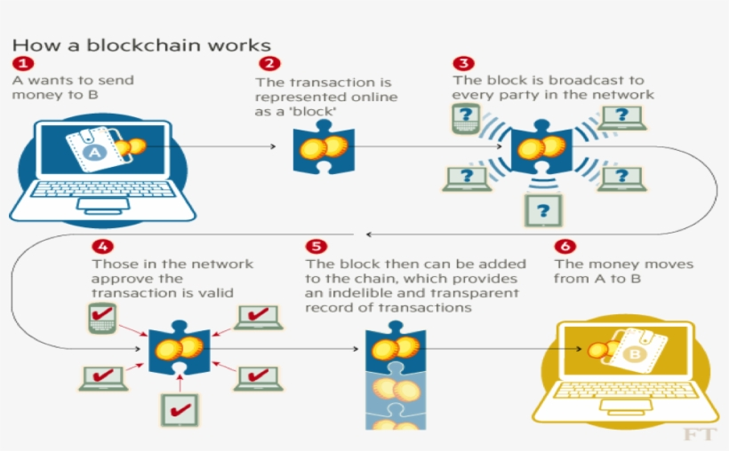
Applications of blockchain technology
Notes:
+ A node starts a transaction by signing it with its private key.
+ The transaction is propagated (flooded) by using much desirable Gossip protocol to peers, which validates the transaction based on pre-set criteria. Usually, more than one node is required to validate the transactions.
+ Once the transaction is validated, it is included in a block, which is then propagated on to the network. At this point, the transaction is considered confirmed.
+ The newly created block now becomes part of the ledger and the next block links itself cryptographically back to this block. This link is a hash pointer. At this stage, the transaction gets its second confirmation and the block gets its first.
+ Transactions are then reconfirmed every time a new block is created. Usually, six confirmations in the bitcoin network are required to consider the transaction final”

Slide 14
Tiers of blockchain technology
Blockchain 1.0: bitcoin and cryptocurrencies
Blockchain 2.0: using in finance
Blockchain 3.0: DApp
Generation X (Blockchain X): blockchain service
Notes:
“invention of bitcoin and is basically used for cryptocurrencies”
“used by financial services and contracts are introduced in this generation. This includes various financial assets, for example derivatives, options, swaps, and bonds”
“to implement applications beyond the financial services industry and are used in more general-purpose industries such as government, health, media, the arts, and justice”
“vision of blockchain singularity where one day we will have a public blockchain service available that anyone can use just like the Google search engine. It will provide services in all realms of society

Slide 15
Types of blockchain
Public blockchains
Private blockchains
Semi-private blockchains
Sidechains
Permissioned ledger
Distributed Ledger
Share ledger
Fully private and proprietary blockchains
Tokenized blockchains
Tokenless blockchains
Notes:
Sidechains: More precisely known as pegged sidechains, this is a concept whereby coins can be moved from one blockchain to another and moved back. Common uses include the creation of new altcoins (alternative cryptocurrencies) whereby coins are burnt as a proof of adequate stake
Share ledger: This is generic term that is used to describe any application or database that is shared by the public or a consortium.
Tokenized blockchains: standard blockchains that generate cryptocurrency as a result of a consensus process via mining or via initial distribution
Tokenless blockchains: These are probably not real blockchains because they lack the basic unit of transfer of value but are still valuable in situations where there is no need to transfer value between nodes and only sharing some data among various already trusted parties is required

Slide 16
Consensus in blockchain
Proof of work
Proof of Stake
Delegated Proof of Stake
Proof of Elapsed Time
Deposit-based consensus
Proof of importance
Federated consensus or federated Byzantine consensus
Reputation-based mechanisms
Practical Byzantine Fault Tolerance
Notes:
PoW: This type of consensus mechanism relies on proof that enough computational resources have been spent before proposing a value for acceptance by the network
PoS: This algorithm works on the idea that a node or user has enough stake in the system; for example the user has invested enough in the system so that any malicious attempt would outweigh the benefits of performing an attack on the system.
This idea was first introduced by Peercoin and is going to be used in the Ethereum blockchain
coin age, which is a derived from the amount of time and the number of coins that have not been spent. The chances of proposing and signing the next block increase with the coin age”
DPoS: each node that has stake in the system can delegate the validation of a transaction to other nodes by voting
PoET: Introduced by Intel, it uses Trusted Execution Environment (TEE) to provide randomness and safety in the leader election process via a guaranteed wait time. It requires the Intel SGX (Software Guard Extensions) processor in order to provide the security guarantee and for it to be secure
Deposit-based consensus: Nodes that wish to participate on the network have to put in a security deposit before they can propose a block
Proof of importance: Proof of importance not only relies on how much stake a user has in the system but it also monitors the usage and movement of tokens by the user to establish a level of trust and importance. This is used in Nemcoin
Federated consensus or federated Byzantine consensus: Used in the stellar consensus protocol, nodes in this protocol keep a group of publicly trusted peers and propagates only those transactions that have been validated by the majority of trusted nodes
Reputation-based mechanisms: A leader is elected on the basis of the reputation it has built over time on the network. This can be based on the voting from other members
Practical Byzantine Fault Tolerance: achieves state machine replication, which provides tolerance against Byzantine nodes. Various other protocols, including but are not limited to PBFT, PAXOS, RAFT, and Federated Byzantine Agreement (FBA), are also being used or have been proposed for use in many different implementations of distributed systems and blockchains

Slide 17
CAP theorem and blockchain
Consistency (C) on the blockchain is not achieved simultaneously with Partition tolerance (P) and Availability (A), but it is achieved over time

Slide 18
Benefits and limitations of blockchain
Decentralization
Transparency and trust
Immutability
High availability
Highly secure
Simplification of current paradigms
Faster dealings
Cost saving
Notes:
Simplification of current paradigms: blockchain can serve as a single shared ledger among interested parties, this can result in simplifying this model by reducing the complexity of managing the separate systems maintained by each entity

Slide 19
Challengers and limitations of blockchain technology
Scalability
Adaptability
Regulation
Relatively immature technology
Privacy

